Slide 1

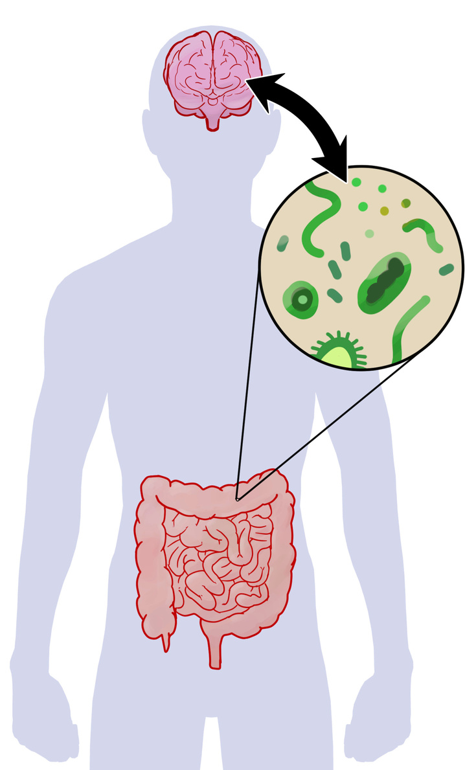


Sleep, Stress, and Exercise
Beyond Diet

Slide 2
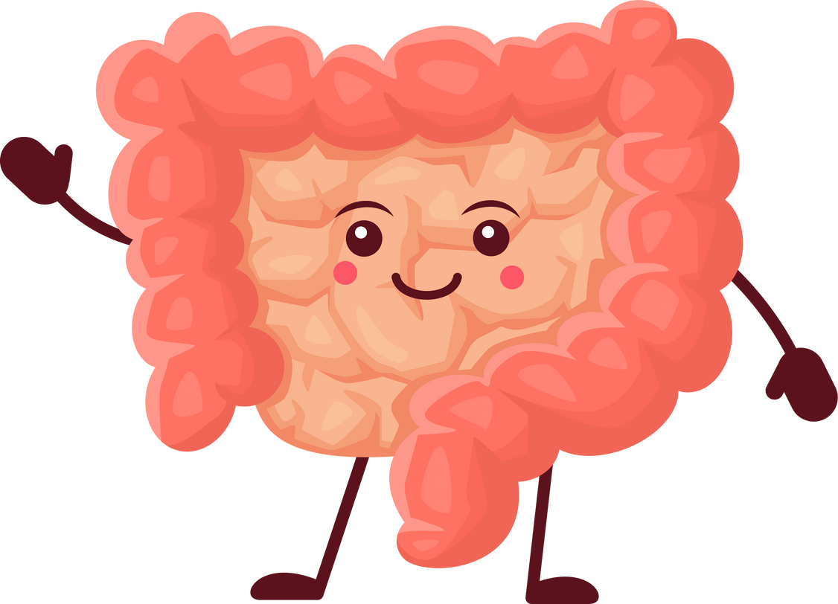
Learning Objectives
Gut - Brain Connection
Factors Beyond Diet that can harm Gut Health
Resources and Tools to Incorporate into your Lifestyle

Slide 3
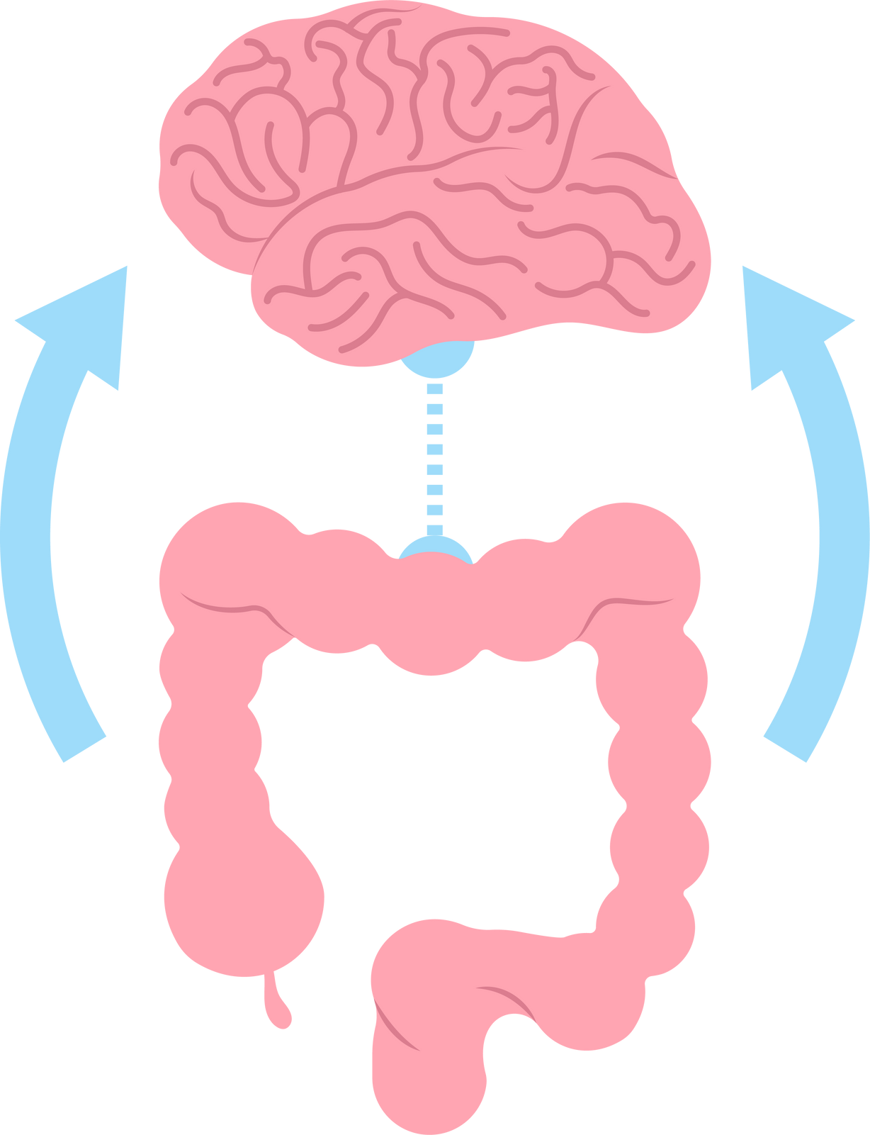


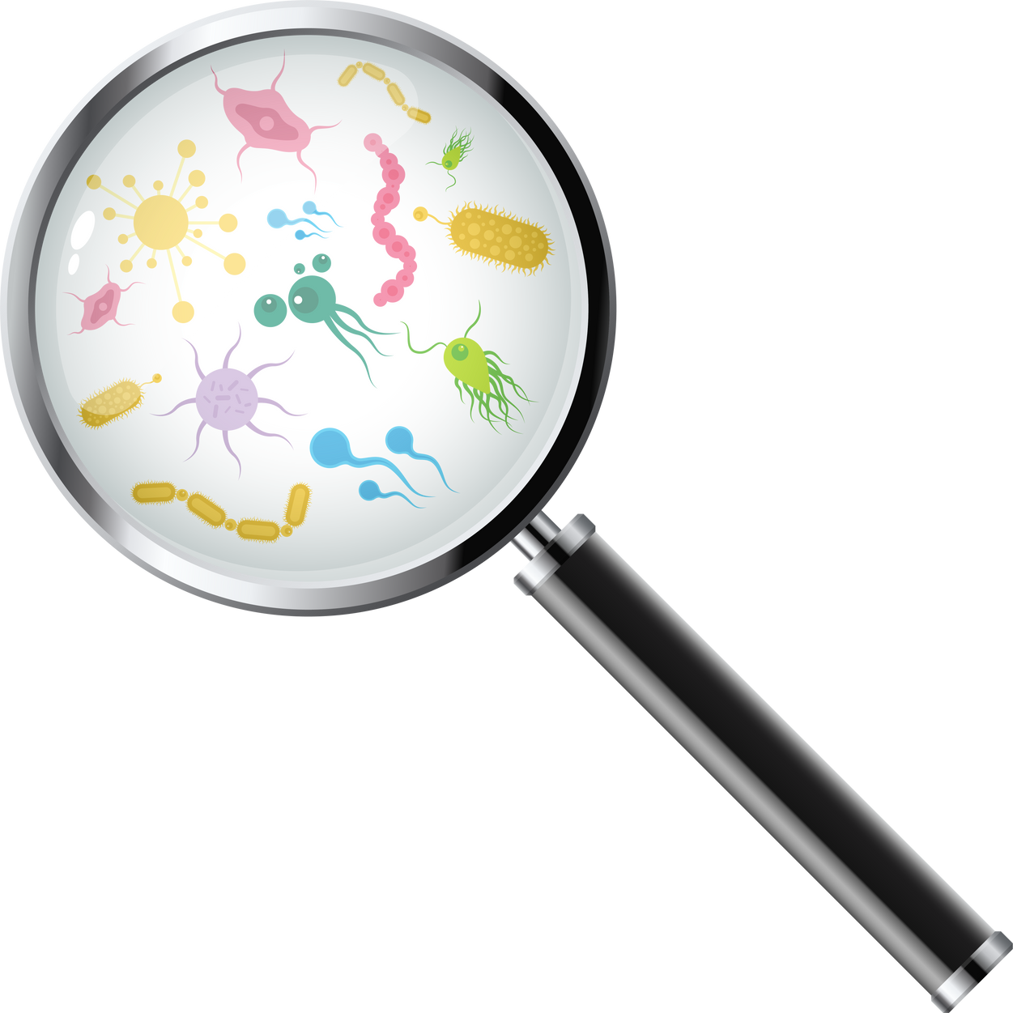
Rewiring the Gut - Brain Axis.
It’s Not in Your Head!
Your Brain Plays a Big Role!
INFLUENCE ON
INFLUENCE ON
Motility
Secretion
Nutrient Delivery
Microbial Balance
Neurotransmitters
Stress / Anxiety
Mood
Behavior
Microbiota
Notes:
The gut-brain axis (GBA) is the two-way communication system between the brain and the gastrointestinal tract. It's a network of nerves, endocrine, immune, and metabolic systems that allows the brain to influence the gut and vice versa.
Neurotransmitters, such as serotonin, are produced primarily in the gut with the help of the trillions of microbes that reside there. In fact, it is estimated that more than 90% of the body’s serotonin is produced in the gut, where it plays a major role in communication between the gut and brain.
Serotonin (5HT) is one of the most important signaling molecules involved in the peristaltic reflex, which moves food along in our digestive tract, and it’s believed that alterations in serotonin signaling may be responsible for IBS symptoms. Serotonin is also fondly called the “feel good hormone,” due to its links to mood and feelings of happiness and well-being, which may also help explain the correlation between gut problems and anxiety or mood disorders.
The role of our gut bacteria is increasingly important as related to the brain and our mental and emotional health. For example, we know that stress can alter the microbial composition of the gut, making it less diverse or more vulnerable to harmful bacteria, which can then lead to increased inflammation, and myriad physical and emotional symptoms.
And, the presence of certain types of gut bacteria can also positively or negatively affect the production of certain brain chemicals. Altered gut bacteria (“dysbiosis”) is linked to a variety of brain-related disorders, including depression, anxiety, Parkinson’s disease, autism and more. Thus, the microbe-gut-brain connection is one we want to care for and protect.

Slide 4
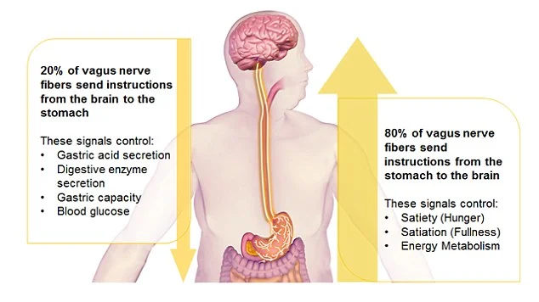
Notes:
When we think of our nervous system, we often think of the central nervous system (CNS): the brain, spinal cord and related neurons (nerve cells). However, the gut contains as many neurons as the spinal cord!
These more than 200 million neurons, present in the lining of the gut, are part of a network called the enteric nervous system (ENS), or your “gut brain” or “second brain,” which is connected to the CNS via the vagus nerve.
The vagus nerve has a variety of functions throughout the body and plays an important role in stress response, for example slowing our heart rate and breathing. In the gut, the vagus nerve serves to control muscle contraction (peristalsis), secretion of certain substances to aid in GI function and digestion of food, and blood flow to the gut. It also relays important messages from the gut brain to the brain via neurotransmitters, or chemical messengers.

Slide 5
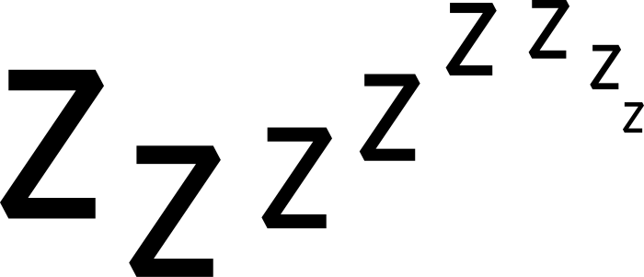
SLEEP
One of the most underrated sources at your disposal to support optimal (gut) health is sleep!
Poor gut health disrupts sleep - regulating hormones
Your sleep - wake cycle relies on the production and proper balance of various hormones and neurotransmitters
  For example, your “happy neurotransmitter”, serotonin. A significant portion of serotonin is actually produced in your gut, an imbalanced GM can hinder its synthesis, leading to reduced serotonin levels and difficulty falling asleep at night.
  Your GM also has a profound impact on the production and metabolism of melatonin - your body’s “sleepy time” hormone. Imbalances in your gut can trigger an overproduction of stress hormone like cortisol which can further disrupt your circadian rhythm and throw off melatonin production.
Notes:
Like our human cells, our GM has a circadian rhythm (a body clock), so disturbed sleep can also affect its natural rhythm.
Studies have shown that sleep deprivation can affect our GM after just two days. Sleep deprivation can also increase inflammation and stress hormones in your body, which may explain why not getting enough sleep is linked with gut symptoms, particularly in people with IBS.
Another study found that partial sleep deprivation increased daily intake by the caloric equivalent of four slices of bread. The study showed the sleep deprived people reached for more high-fat, lower-protein foods, keeping all the nutrition to themselves and leaving none for their poor GM.
When you haven't had enough sleep, your are also more susceptible to getting sick.
Think about your sleep quality. How refreshed do you feel most days?

Slide 6
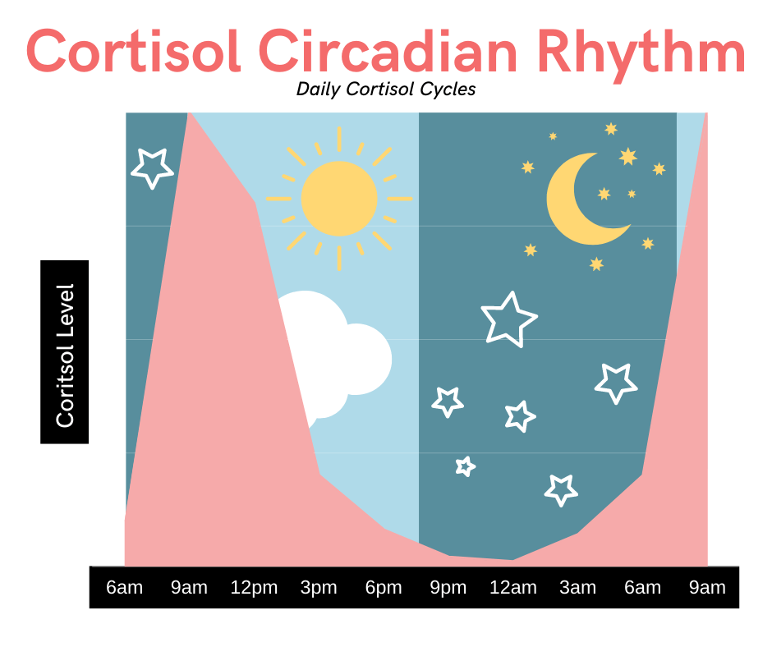
Notes:
When we think of our nervous system, we often think of the central nervous system (CNS): the brain, spinal cord and related neurons (nerve cells). However, the gut contains as many neurons as the spinal cord!
These more than 200 million neurons, present in the lining of the gut, are part of a network called the enteric nervous system (ENS), or your “gut brain” or “second brain,” which is connected to the CNS via the vagus nerve.
The vagus nerve has a variety of functions throughout the body and plays an important role in stress response, for example slowing our heart rate and breathing. In the gut, the vagus nerve serves to control muscle contraction (peristalsis), secretion of certain substances to aid in GI function and digestion of food, and blood flow to the gut. It also relays important messages from the gut brain to the brain via neurotransmitters, or chemical messengers.

Slide 7
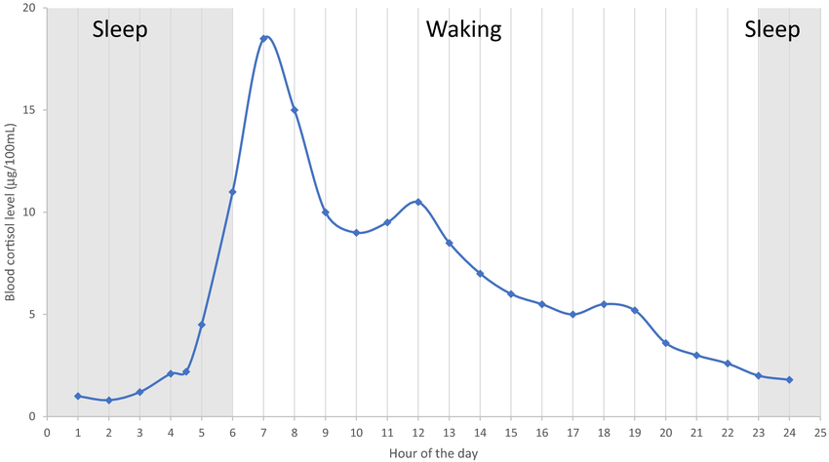
Notes:
When we think of our nervous system, we often think of the central nervous system (CNS): the brain, spinal cord and related neurons (nerve cells). However, the gut contains as many neurons as the spinal cord!
These more than 200 million neurons, present in the lining of the gut, are part of a network called the enteric nervous system (ENS), or your “gut brain” or “second brain,” which is connected to the CNS via the vagus nerve.
The vagus nerve has a variety of functions throughout the body and plays an important role in stress response, for example slowing our heart rate and breathing. In the gut, the vagus nerve serves to control muscle contraction (peristalsis), secretion of certain substances to aid in GI function and digestion of food, and blood flow to the gut. It also relays important messages from the gut brain to the brain via neurotransmitters, or chemical messengers.

Slide 8
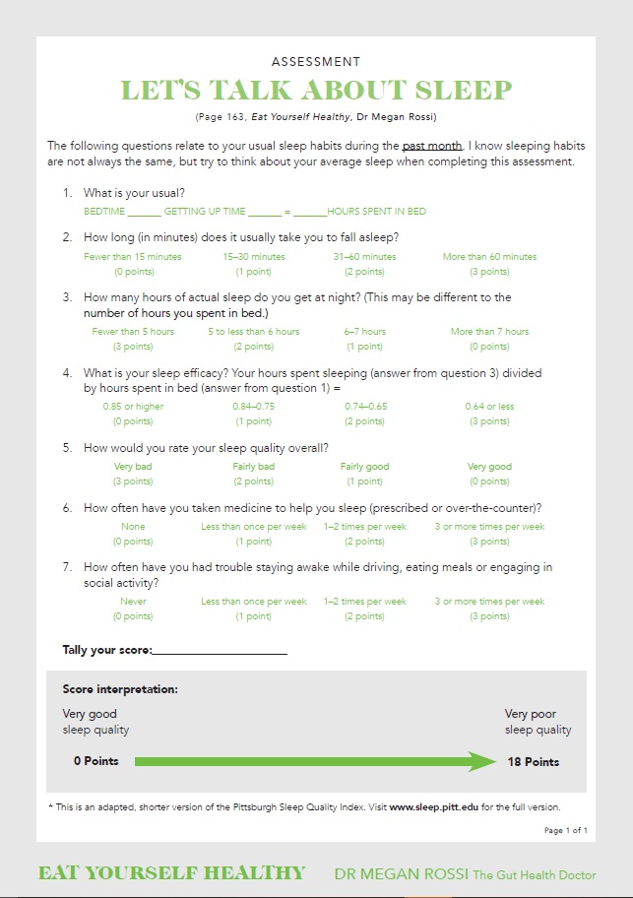
Assessment:
Let’s Talk About Sleep
SLEEP
The following questions related to your usual sleep habits during the past month. I know sleeping habits are not always the same, but try to think about your average sleep when completing this assessment.

Slide 9
Sleep - Hygiene Protocol
SLEEP
What does sleep hygiene actually mean?
It’s a phrase that describes the habits you can put in place to optimize the length and quality of your sleep. The result? You feel much more well rested and begin to reap the effects, including benefits to your immunity, dit, and other areas of your well - being, such as mood.
STEP 1:
Identify 4 habits from the sleep challenge that are relevant and realistic targets for your lifestyle.
STEP 2:
Implement your chosen strategies for a minimum of 4 weeks.
STEP 3:
After 4 weeks, reassess your sleep quality use the sleep quality assessment (“Let’s Talk about Sleep”)
STEP 4:
Reevaluate your selected strategies and adjust as needed, keeping in mind that it typically takes 9 weeks of daily practice to form a habit (or 60 days).

Slide 10
Sleep Hygiene
SLEEP
Make your Bedroom Cave - Like
  Black out curtains for dark room
  Tape over any small lights in bedroom
  Make it cool when going to sleep
  Make it a goal to go to bed around the same time and wake up.
Get the Best Sleep of your Life!
  Make it a goal to go to bed around the same time and wake up
  No alcohol at least 4 hours before bed or cut back or out
  Cut off caffeine at least by 3 PM, at best by Noon
  Quick to -to sleepy supplements:
    Magnesium Glycinate
    Topical Magnesium
    Saffron
    Rhodiola Rosea
  No phone in your bedroom or 1 hour before bed
  Optional
    Blue Light Blocking Glass
    Mouth Tape
    Weighted Blanket
    Nature Sounds
    Certain Scents like forrest smells: Lavender, Jasmine, Sandalwood, Sweet Marjoram, Cedar, Geranium
    Calming Sounds

Slide 11


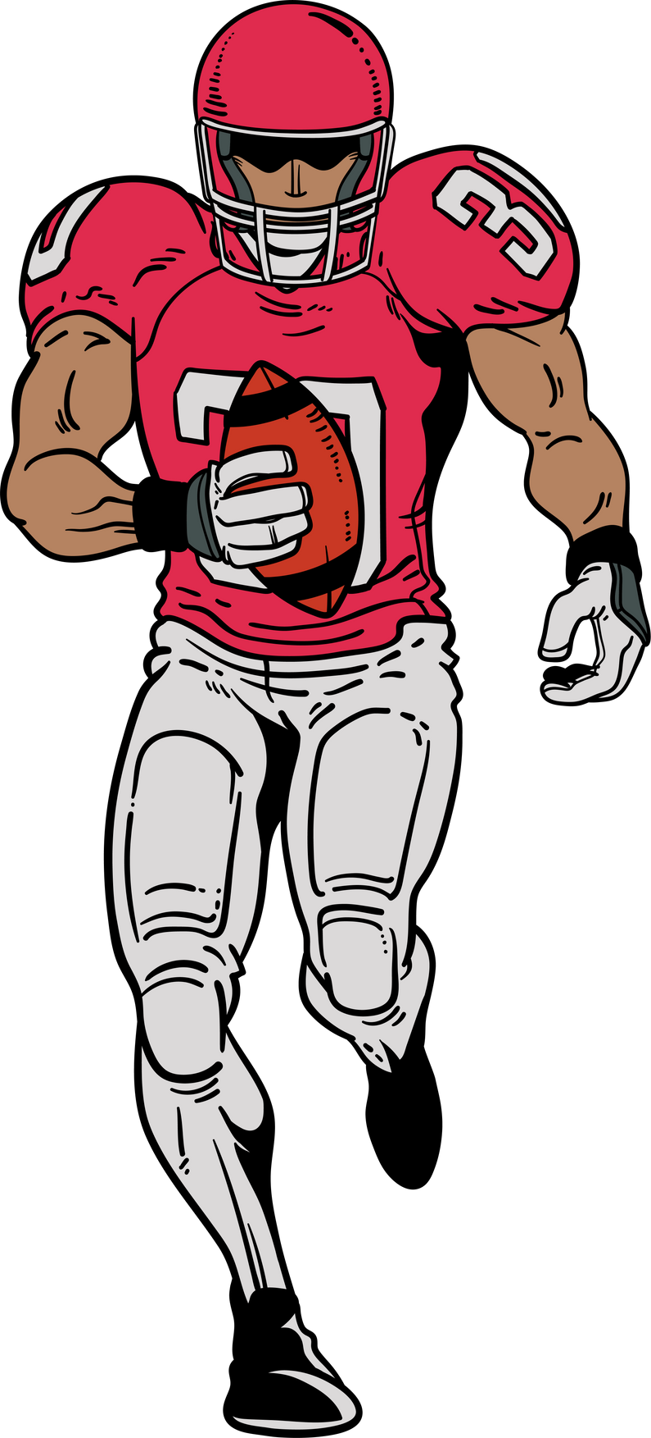
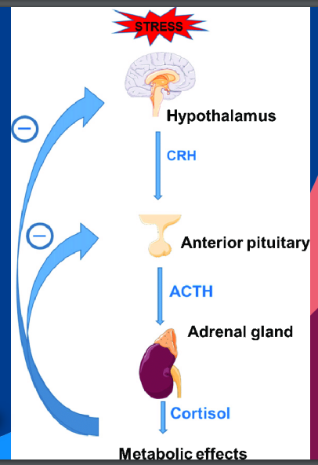
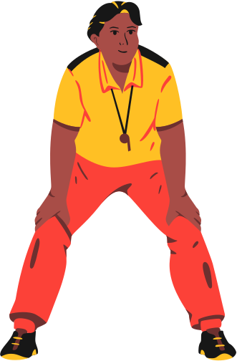
STRESS
What is the HPA Axis?
Hypothalamus (Brain + Endocrine System) Head Coach!
Pituitary Gland (Regulate growth, metabolism and reproduction) Head Coach!
Adrenal Glands (Cortisol, adrenaline and sex hormones) Head Coach!
HPA - Dysfunction
Digestive Hormones (special teams) - Stomach, SI, Pancreas (coach)
Sex Hormones (special teams) - Ovaries + Assistants (coach)
Thyroid Hormones (special teams) - Thyroid gland + Activation Assistants (coach)
Stress hormone (special teams) - Adrenal Gland + Adrenal Coaches (coach)
Notes:
The hypothalamic-pituitary-adrenal (HPA) axis is a hormonal system that helps the body respond to stress. When activated, the HPA axis releases cortisol, a hormone that triggers short-term changes in the body to help you deal with stress. The HPA axis is a key part of the body's stress response system, which is similar to a smoke alarm that alerts the body to a potential problem
It is well known that IBS is a disorder that is highly correlated with stress. Studies have shown that approximately 60% of IBS patients report the first onset or flare of symptoms in association with psychosocial stressors, such as anxiety, depression, chronic disease, job stress, family concerns or others.
Stress plays an important role in triggering IBS symptoms, as the brain has an increased sensitivity to stressors and responds with reactions or symptoms in the gut. Stress can affect the movement and contractions of the GI tract by activating specific hormones in the body, such as cortisol, which may divert blood flow from the gut, affecting digestion and overall GI function. Stressors can also affect hasten or slow the movement of the GI tract.
As an example, consider how stress makes your bowels respond when you’re readying for a big presentation or that important 10K race! In addition, stress-based thoughts, feelings and activation of parts of the brain that have to do with anxiety or arousal can stimulate exaggerated gut responses and increase gut sensitivity.

Slide 12
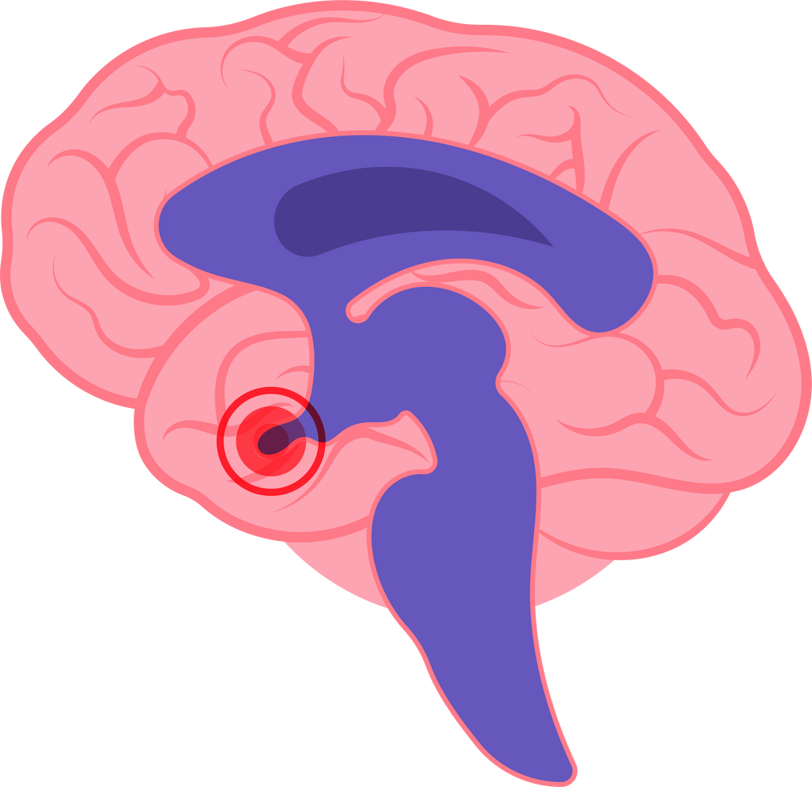
Hormones - Cortisol (Stress Hormone)
Hypothalamic Pituitary Adrenal (HPA) axis
The HPA is the body’s stress system. The Hypothalamus, the main regulatory center of the brain, senses stress.
  When it does, it releases a hormone to the pituitary gland, a gland in the brain that controls hormone function in the body.
  The pituitary gland will then release a hormone that signals the adrenal glands that we are under stress, including cortisol.
  Cortisol affects various metabolic functions, includes blood pressure and blood sugar. It also has a significant effect on the GI (decreased stomach emptying, diarrhea and increased sensitivity.
  “Leaky Gut” may be another result of stress.
  High stress levels can be an attributing factor in the development of “SIBO”
STRESS

Slide 13
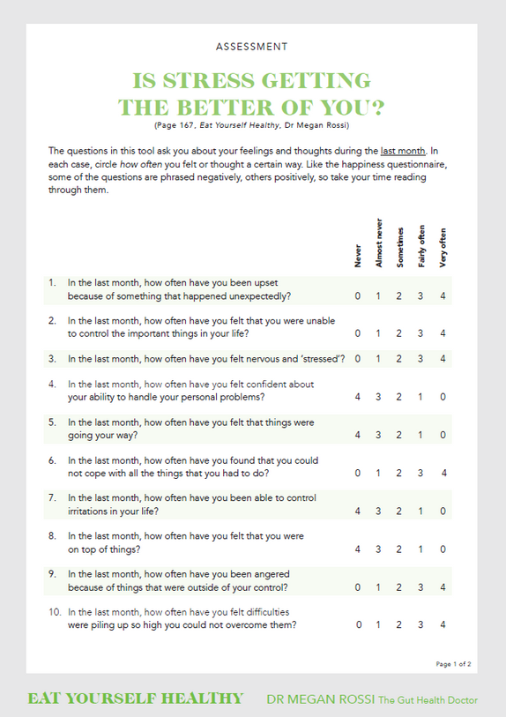
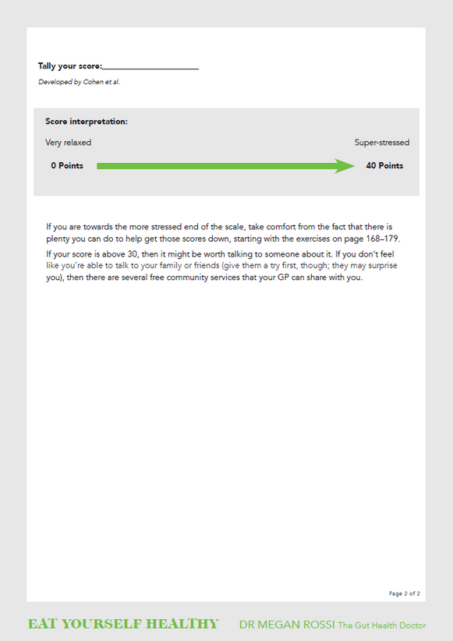
Assessment: Is Stress Getting the Best of You?
The questions in this tool ask you about your feelings and thoughts during the last month. In each case, circle how often you felt or thought a certain way. Like the happiness questionnaire, some of the questions are phrased negatively, and others positvely, so take your time reading through them.
STRESS
Notes:
Although it's normal and often beneficial for everyone to get a little stressed from time to time, if it's frequent or debilitating when it does strike, your (gut) health is likely paying the price. Even if you don't think you're stressed, it's worth checking.

Slide 14
The Strategies
EXERCISE 1 - THE DO NOTHING EXERCISE
Pick a point in the day where you do absolutely nothing. Ideally, it’s best to lie down so that there isn’t even any physical stimulation. With that in mind, many people find it best to do this at the end of the working day, when thy get home.
  Place a notepad and pen beside you
  Set a timer for ten minutes
  Lie down on your back; you can have your knees up or down, whichever is more comfortable. Rest your hands on your tummy or by your side.
  Take one or two breaths to settle yourself, and then just notice what happens.
  At the end of 10 minutes, write down your observations.
STRESS
HOW DOES YOUR BODY FEEL?
WHAT MOOD ARE YOU IN?
WHAT’S HAPPENING IN YOUR MIND.
Notes:
How does your body feel? Are your shoulders or neck tight? Is your breathing deep or shallow?
What mood are you in? Are you tired? Relaxed? Anxious? Do you feel guilty for "wasting time"?
What's happening in your mind? Are you thinking about your to-do list? Are you counting down the minutes before you can get up again? Maybe other thoughts or ideas come to mind.

Slide 15
The Strategies
EXERCISE 2 - CHALLENGING JUDGMENTAL THOUGHTS
One way to start challenging judgmental thoughts about yourself is to imagine you are hearing your own story from someone else.
  Try directing the more supportive thoughts to yourself.
  It’s important to begin with something that feels manageable, so start by challenging just one critical thought that you’ve experienced.
  Once that positive challenge becomes automatic, you can move on to another critical thought.
STRESS
Notes:
The do - nothing exercise often throws light on our unconscious mental habits. Typically, we hold ourselves to much higher standards than we do others. We are much more critical of ourselves than we would be of a friend, or even a stranger, in the same situation. This constant internal pressure is a major driver of stress and poor coping. Recognizing and managing stress is dependent on our ability to be compassionate to ourselves, to treat ourselves like we would our best friend.

Slide 16
Switching from high intensity workouts to low intensity
  For example - 7 days a week to 4 - 5 days a week
  This can look like slow weight lifting, pilates, body weight workouts with active recovery days (walking, stretching, mobility)
Eat before (and after) workout
STRESS
  Eat at least a carb with fat before workouts to give your body its preferred energy source. This will help reduce the exercise - induced cortisol response.
  Eat carb + fat at least, and at best protein + carb
    Banana (carb) + nuts (fat) or 1/2 banana + nuts, Eggs (protein + fat) + berries (carb)
    Can’t eat a lot? Berries, nuts or 1/2 banana + nuts are 2 easy examples
    Best thing to eat after a workout is a protein + carb. Protein repairs muscle, carb replenishes energy stores!
Cortisol Cheats
Add in Walking! (10 - 40 minutes)
  helps regulate blood sugar
  low intensity

Slide 17
Add in squats during the day
  A new study found: 10 bodyweight squats every 45 minutes during an 8.5 hour period of sitting improves blood sugar regulation.
Delaying Caffeine and Cortisol (60 - 90 minutes after waking)
STRESS
  Natural Cortisol Peak: Cortisol levels naturally peak n the early morning (around 30 - 45 minutes after waking), helping to wake you up and increase alertness.
  Avoid Amplifying Stress: Consuming caffeine during this peak can further increase cortisol levels, potentially leading to increased stress and anxiety.
  Optimal Timing: Delaying caffeine intake until 60 - 90 minutes after waking allows cortisol levels to regain its natural rhythm.
  Making a nourishing drink swap or gradually cut back on the amount of coffee/caffeine consumed.
  If you have morning anxiety, caffeine is not recommended.
Cortisol Cheats
No Caffeine after 3 PM, at best none after 12 PM
  Easily help your sleep - wake cycle with this

Slide 18
Eating Before Caffeine and Cortisol
  Blood Sugar Stability: Eating a balanced meal before consuming caffeine helps stabilize blood sugar levels, preventing spikes and crashes that can affect energy and mood.
  Cortisol Regulation: Consuming food before caffeine can mitigate the cortisol - raising effects of caffeine, promoting a more balanced stress response.
Eat a Blood Sugar Balanced Meal Upon Waking
STRESS
  This includes a combination of macronutrients - carbohydrates, proteins and fats. They work together to stabilize blood sugar levels, preventing sharp spikes and crashes. This balance helps maintain steady energy levels, reduce cravings and support overall health.
Cortisol Cheats
Eat Enough Throughout the Day
  1200 calories is NOT enough!
  Action Item:Aim for 3 meals and some snacks
  Each meal has a protein, carb and fat (remember blood sugar balance)
  Low blood sugar will spike cortisol stress in the body. In turn cortisol causes insulin to spike and crash which not only makes us feel icky and anxious but it also puts stress on the adrenals.

Slide 19
Cold Water Exposure (2 - 4 times a week or daily)
  Best to do in morning
  Remember, something is better than nothing
  For 1 - 2 minutes - Rinse off with cold water at the end of your shower, can just face and not body.
  Face plunge in cold water
  Splash cold water on your face and neck
  Rub an ice cube along face and neck
STRESS
Morning Sun Exposure
Cortisol Cheats
  Face to sun, even when cloudy for ideally 15 minutes
  If you have trouble falling asleep, this alone can be a big came changer for you
Evening Sun Exposure
  Watching the sunset can have the same benefits as morning sun exposure
  Face to sun, even when cloudy ideally for 15 minutes
Can’t do Sun Exposure due to scheduling?
  Add in red light therapy upon waking and before bed

Slide 20
Digital Detox
  This means you put your phone away, and even the TV if you want, for a certain amount of time or certain time fo the day.
  Morning - No phone first thing, swap it for vagal toning!
  Evening - at least an hour before bed NO phone or anything too stimulating.
  Replace screen time with other activities such as walking, playing games, reading a book, relaxing to music
  Set a timeframe
STRESS
Cortisol Cheats
Morning Sun Exposure
  Face to sun, even when cloudy for ideally 15 minutes
  If you have trouble falling asleep, this alone can be a big came changer for you
Evening Sun Exposure
  Watching the sunset can have the same benefits as morning sun exposure
  Face to sun, even when cloudy ideally for 15 minutes
Can’t do Sun Exposure due to scheduling?
  Add in red light therapy upon waking and before bed

Slide 21
Nourishing Drink
  Electrolytes
  Minerals
  Teas
  Adaptogenic Herbs
  vitamin C (supports the adrenal glands and the HPA axis which directly impacts your mood, stress response, immunity, and energy. Plus when stressed your body needs 3x more vitamin C than normal.
STRESS
Cortisol Cheats
Grounding for 5 - 10 minutes anytime of day
  Grounding, also known as earthing, involves making direct contact with the Earth’s surface, such as walking barefoot on grass, sand, or soil. This practice is based on the idea that connecting with the Earth’s electrons can have positive effects on your health
    Walk Barefoot
    Sit or Lie on the Ground
    Grounding Mats and Sheets
    Water Grounding
Notes:
Grounding works by allowing your body to absorb free electrons from the Earth. These electrons act as antioxidants, neutralizing harmful free radicals and reducing inflammation. The physical connection with the
Earth can help balance the electrical charges in your body. This can help with stress, cortisol, anxiety, sleep-wake cycle, and decrease inflammation.
Walk Barefoot:
Spend at least 5-30 minutes each day walking barefoot on natural
surfaces like grass, sand, or soil. This is one of the easiest and most
effective ways to practice grounding.
2.Sit or Lie on the Ground:
Take breaks during your day to sit or lie down on the ground. Bring a
blanket or yoga mat to a park and enjoy a grounding session while
reading or meditating.
3.Grounding Mats and Sheets:
Use grounding mats or sheets at home. These products are designed to
simulate the grounding effect by connecting to the Earth through your
home's grounding system.
4.Water Grounding:
Spend time in natural bodies of water like oceans, lakes, or rivers.
Walking along the shoreline or swimming can provide grounding
benefits.

Slide 22
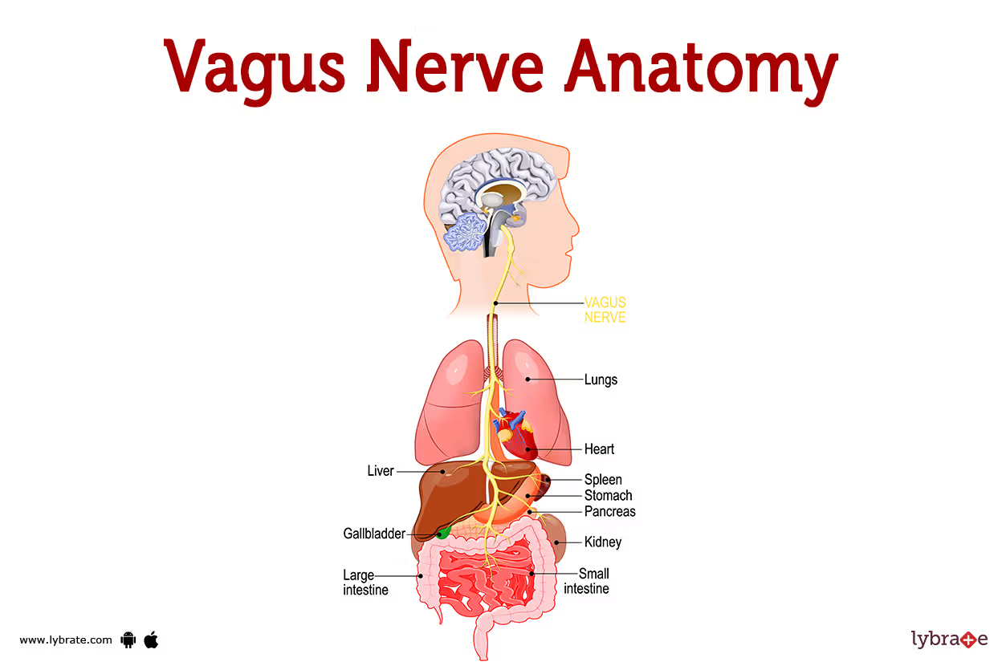
Vagus Nerve - Vagal Toning
The vagus nerve is in charge of the parasympathetic nervous system (PNS). So, the term “vagal tone” describes the function of the PNS.
Does the PNS work well to balance out the sympathetic response? Or is it inhibited? Think of it like muscle tone. Is it strong, or is it weak? Do you feel rigid, tense and anxious, or flexible and resilient?
STRESS

Slide 23

Vagal Toning Breathwork
Diaphragmic Breathing
STRESS
Ocean Breathing
Chin Lock
Pleasureable Huh
Alternative Nostril

Slide 24

Vagal Toning Activities
Butterfly Tapping
STRESS
Ear Massage
Neck Massage

Slide 25

Vagal Toning/Somatic Exercises
Trapezius Twist
STRESS
Salamander
Ribcage Tapping Combo

Slide 26

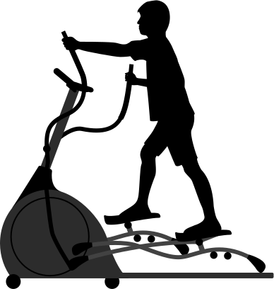

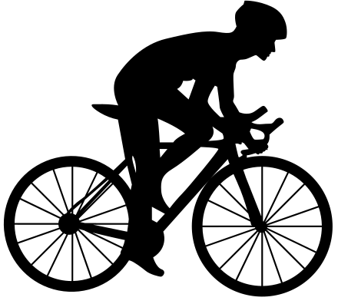



EXERCISE
When it comes to the type of exercise, funnily enough, your GM likes whatever you do. As long as you’re moving your body often, getting your heart rate up for at least 30 minutes most days, you’ll be satisfying everyone’s needs.
Remember strenuous exercise can cause the body to release cortisol. Be mindful to not over exercise.
Notes:
We all know exercise is good for us, but the idea it also benefits our GM may be the extra incentive we need to get moving.

Slide 27
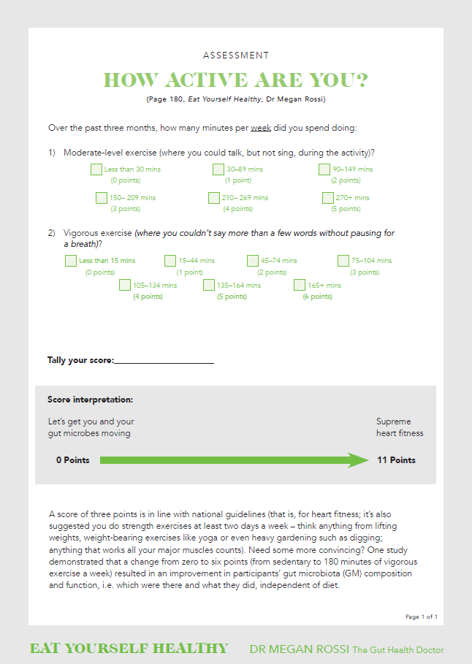
Assessment:
How Active Are You?
So how are your fitness levels? Over the past 3 months, how many minutes per week did you spend doing:
EXERCISE
Notes:
A score of 3 ponts is line with national guidelines (that is, for heart fitness; it's also suggested that you do strength exercises at least 2 days a week - anything from lifting weights, weight bearing exercises like yoga or even heavy gardening such as digging; anything that works all your major muscles count).
Need more convincing? One study demonstrated that a change from 0 to 6 points (from sedentary to 180 minutes of vigorous exercise a week) resulted in an improvement in participants' GM composition and function, example, which bacteria were there and that they did, independent of diet.

Slide 28
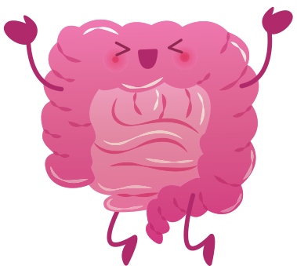
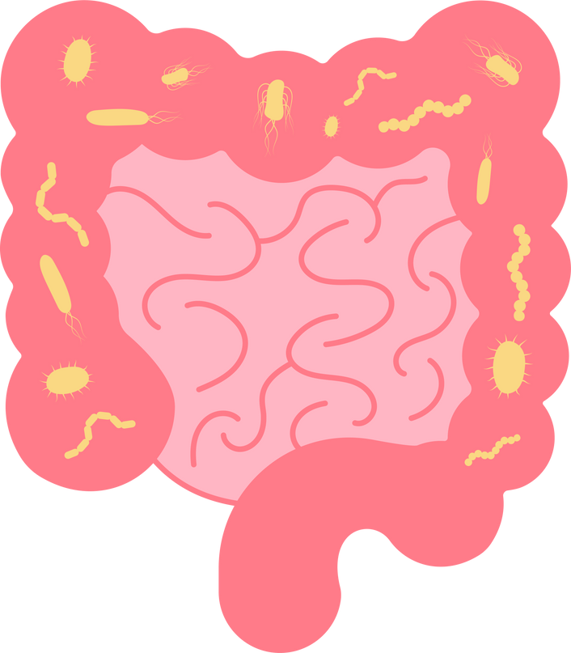
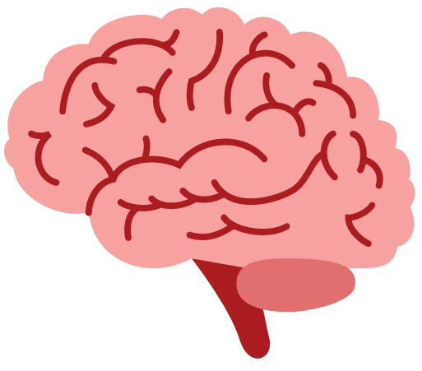
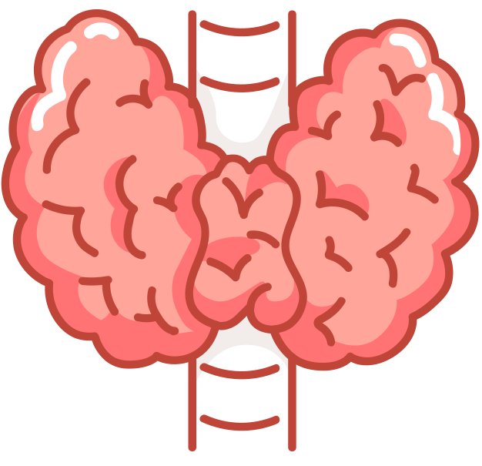
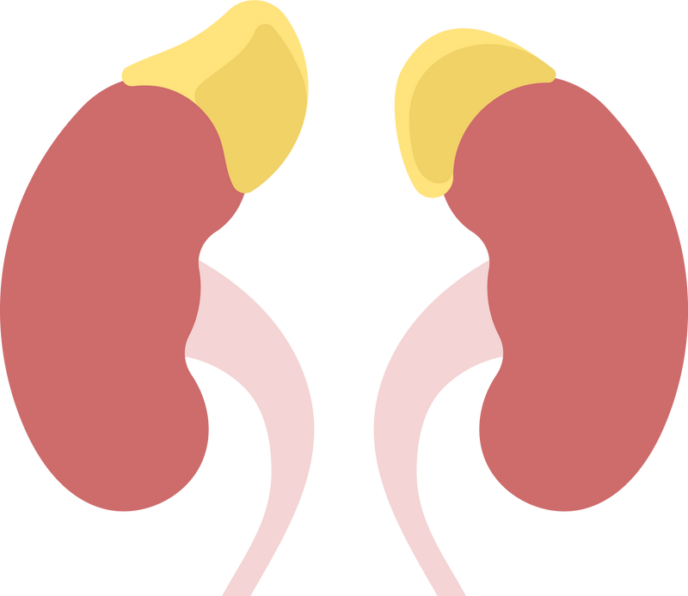
Take Away
Happy Gut = Happy Hormones!

Slide 29



Resources

Slide 30



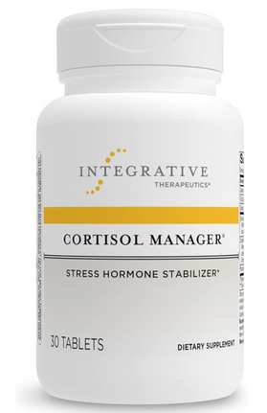
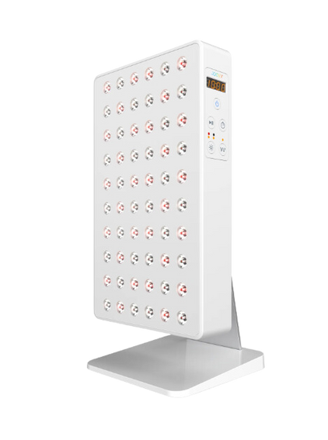


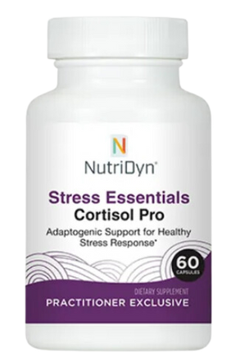

Resources

Slide 31

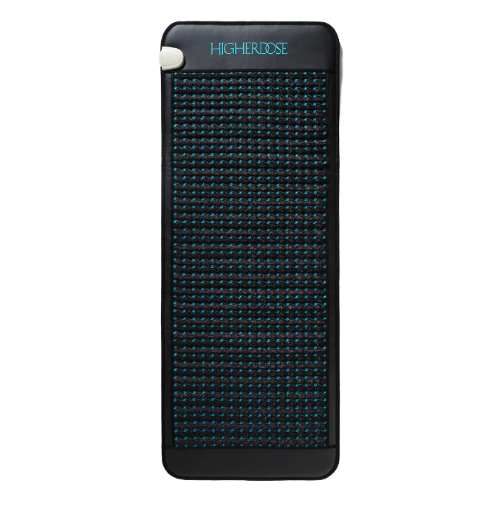
Resources

Slide 32

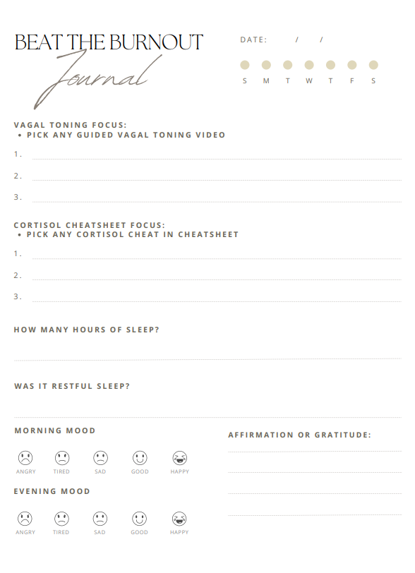
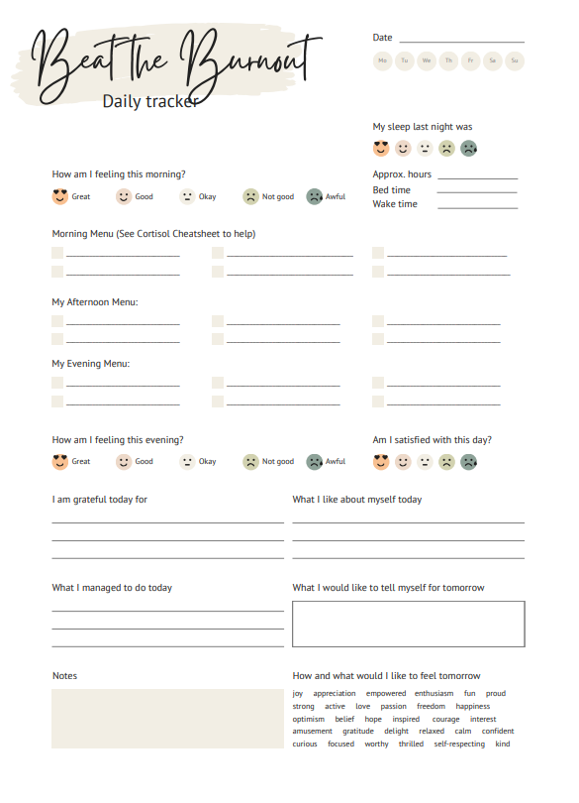
Next Challenage

